Slide 1
Vendor C-CDA to FHIR mapping review and alignment

Slide 2
Agenda
Go over the timeline and scope for the September ballot, and plan for the vendor calls
Schedule another meeting (potentially 1.5h) on the books – Thursday 2pm ET
Point vendors to the page of open questions
Alignment artifacts will be posted on the github repo along the way (Quick tour)
Your feedback is highly valued, so speak up! ☺
Notes:
Github: https://github.com/chunli866/CCDAtoFHIRSamples/tree/main
Publication: https://build.fhir.org/ig/HL7/ccda-on-fhir/mappingBackground.html
Publication branch with the expanded clinical domains: https://build.fhir.org/ig/HL7/ccda-on-fhir/branches/2024/CF-index.html
May 2024 Connectathon C-CDA to FHIR track report-out:
https://docs.google.com/document/d/1dJQ79zuRpFmWicBaNpsnnw8wXHDid81NXUKKJ12wJCc/edit

Slide 3
PAMPI Gaps Filling - Patient

Slide 4
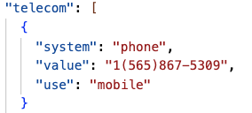
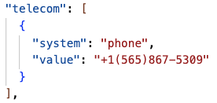
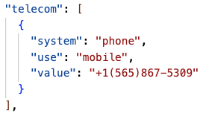
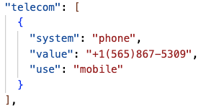
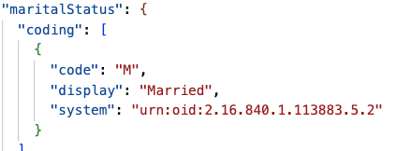
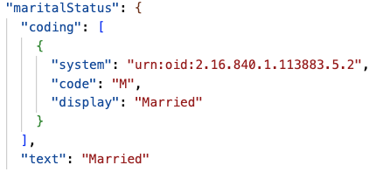
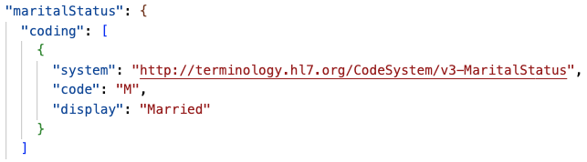
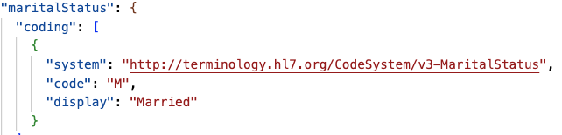
Telecom
Availity
Google
MDIX
Smile
Marital Status

Slide 5
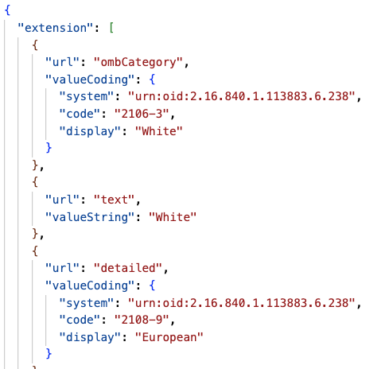
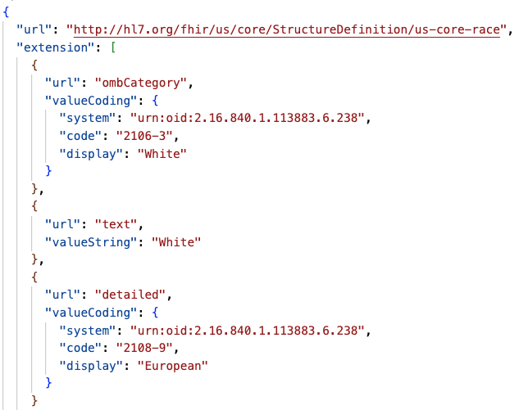
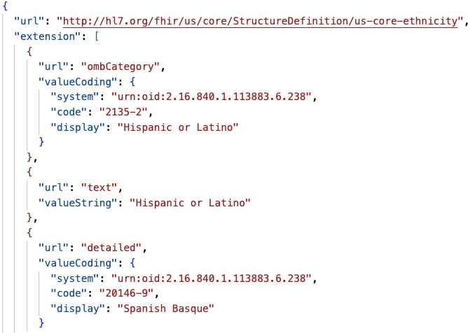
Additional Race and Ethnicity
RACE
Ethnicity
Availity
Smile
Smile

Slide 6
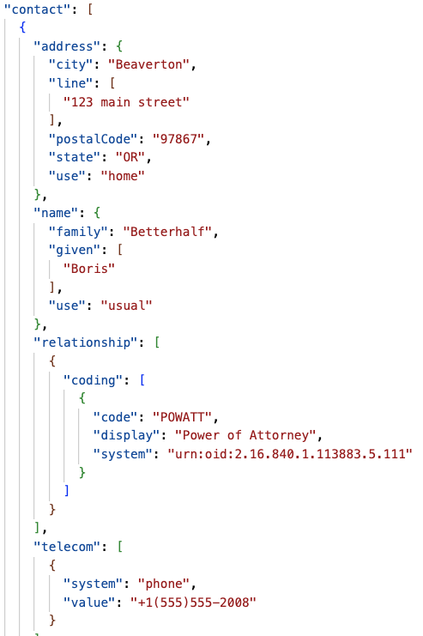
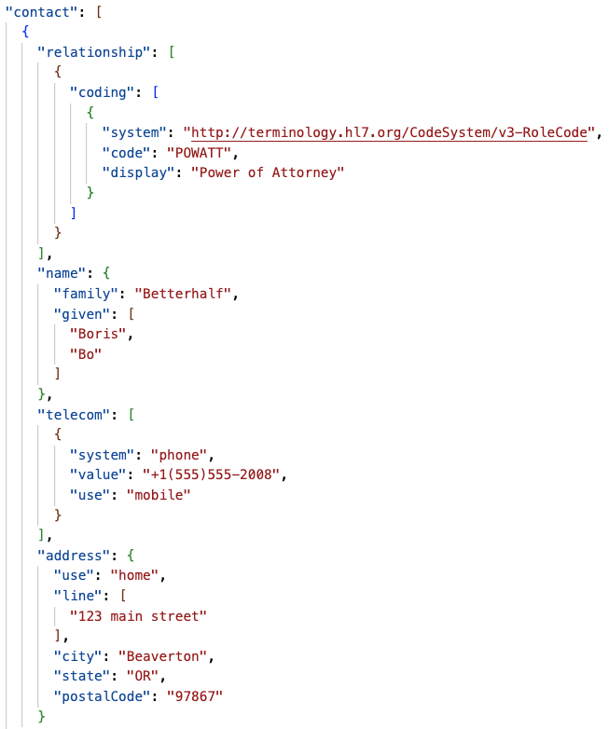
Guardian
Google
Smile

Slide 7
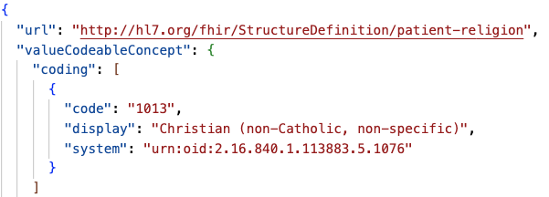
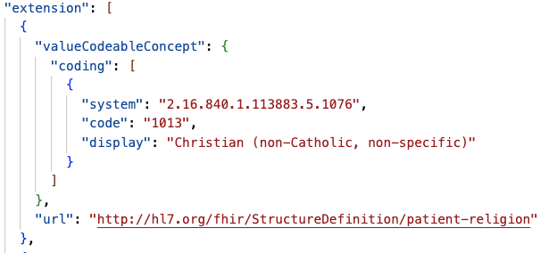
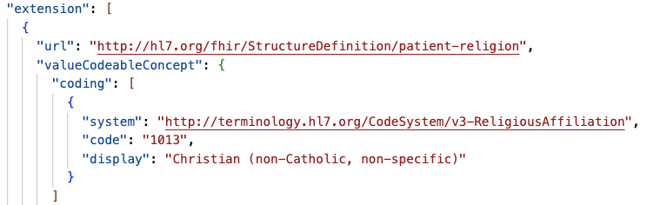
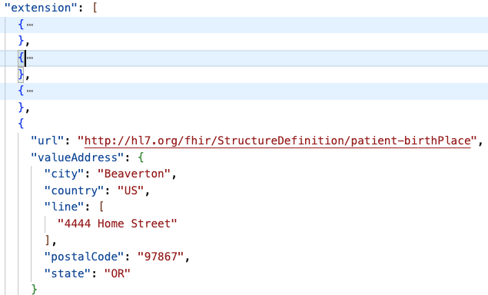
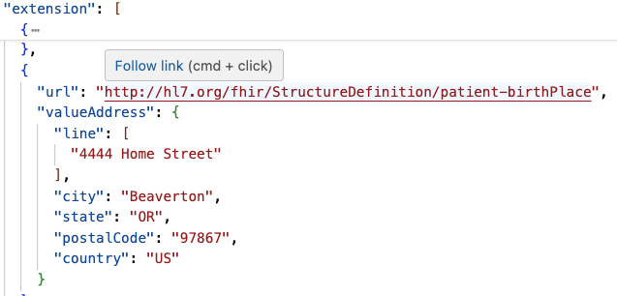
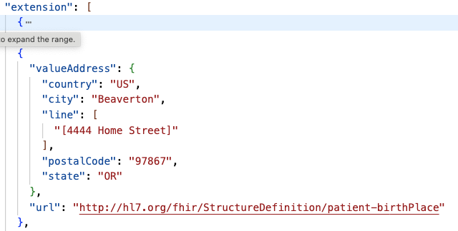
Google
MDIX
Smile
Religion
Birthplace

Slide 8
Missing attributes for all vendors
Language:
modeCode
proficiency level code

Slide 9
PAMPI Gaps Filling - Allergies

Slide 10
 | Availity res. No. | Google res. No. | MDIX res. No. | Oracle res. No. | Smile res. No.
Total Res | 4 | 3 | 3 | 4 | 2
1st entry | 1 | 1 | 1 | 1 | 1
2nd entry | 2 | 2 | 2 | 3
3rd entry | 3 | 3 | 3 | 4 | 2
Availity and Oracle mapped an additional allergyIntolerance resource (O_Allergy2 and AV_Allergy4) that have no code; seems an result of trying to accommodate a practitioner from the first entry
Status ER appeared to not mapped by any vendor (3rd entry in CCD); all vendors are mapping from the act status only

Slide 11
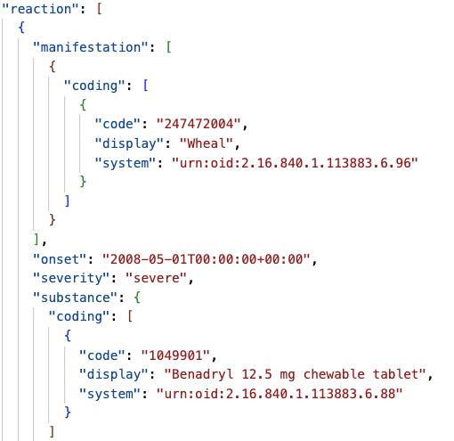
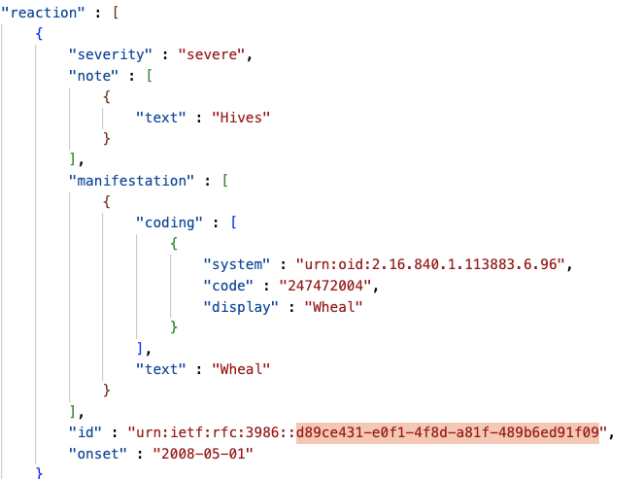
Reaction.Medication activity
Reaction ID and Onset
Google
MDIX
Only Google mapped but not correctly – did we land on the right way?
Only MDIX mapped both; G/S/O mapped onset the same way with M; A didn’t map

Slide 12
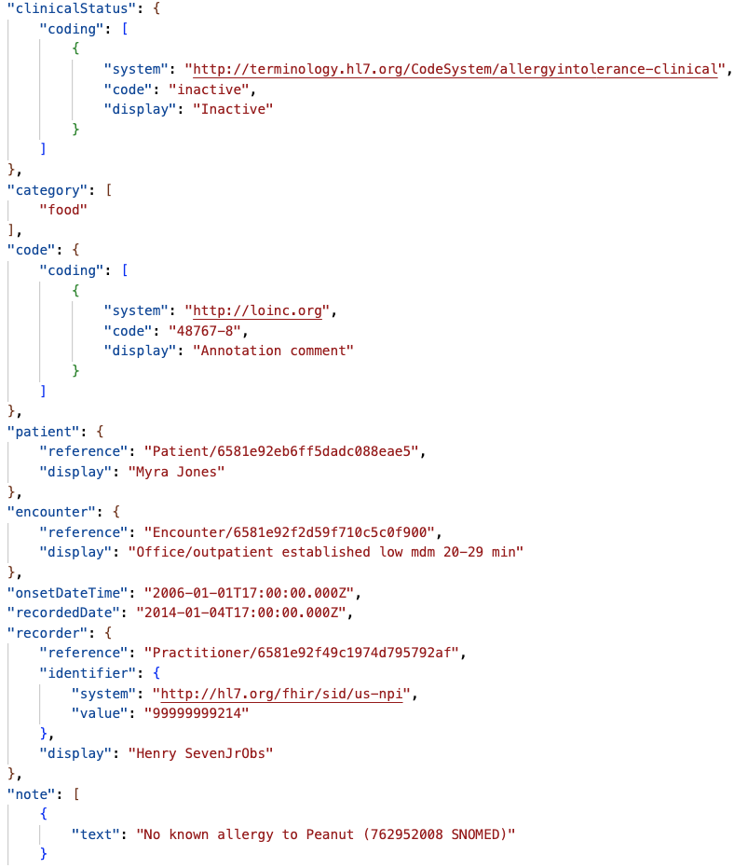
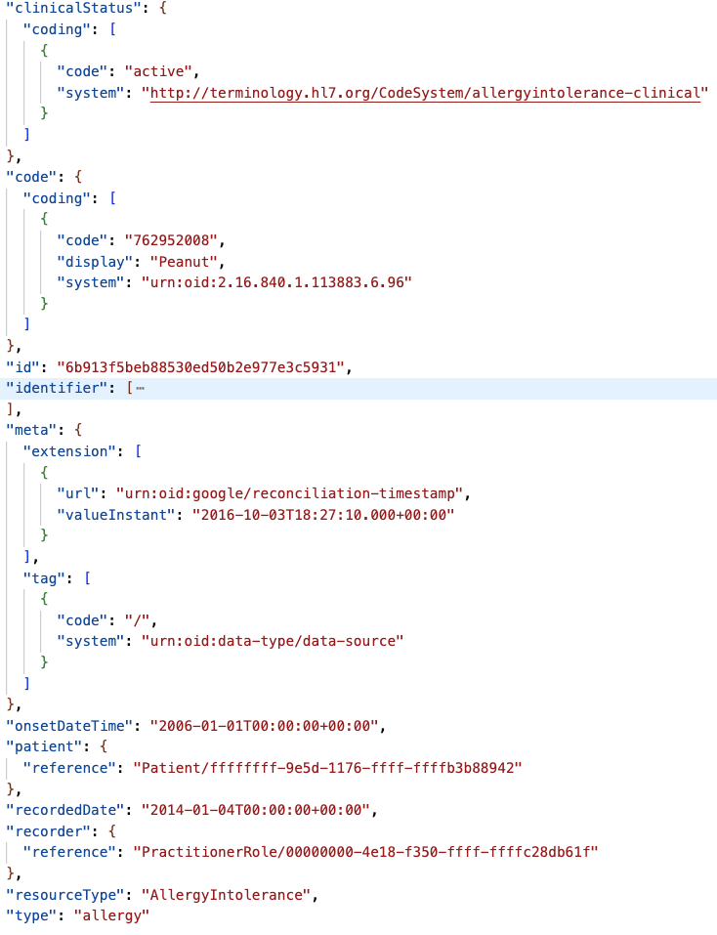
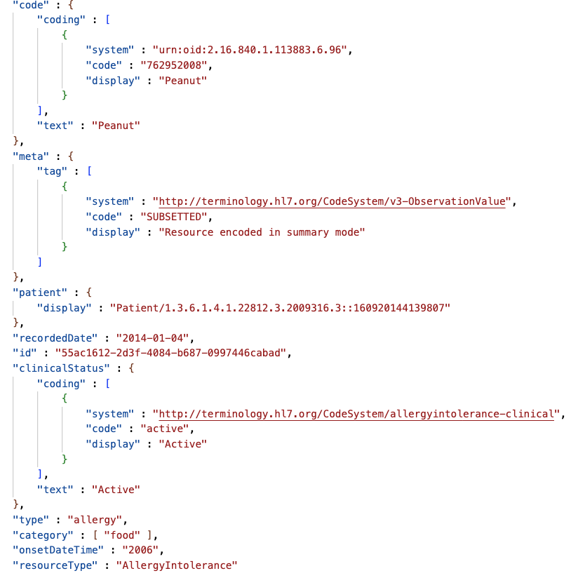
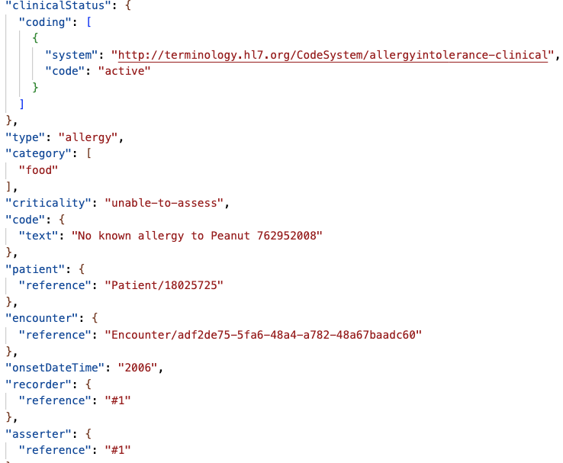
AV: allergy2
G:a2
M:a2
O:a3
S: skipped the resource
Negation –
presented in 2 mappings, not presented in 2, and entry/resource skipped in 1

Slide 13
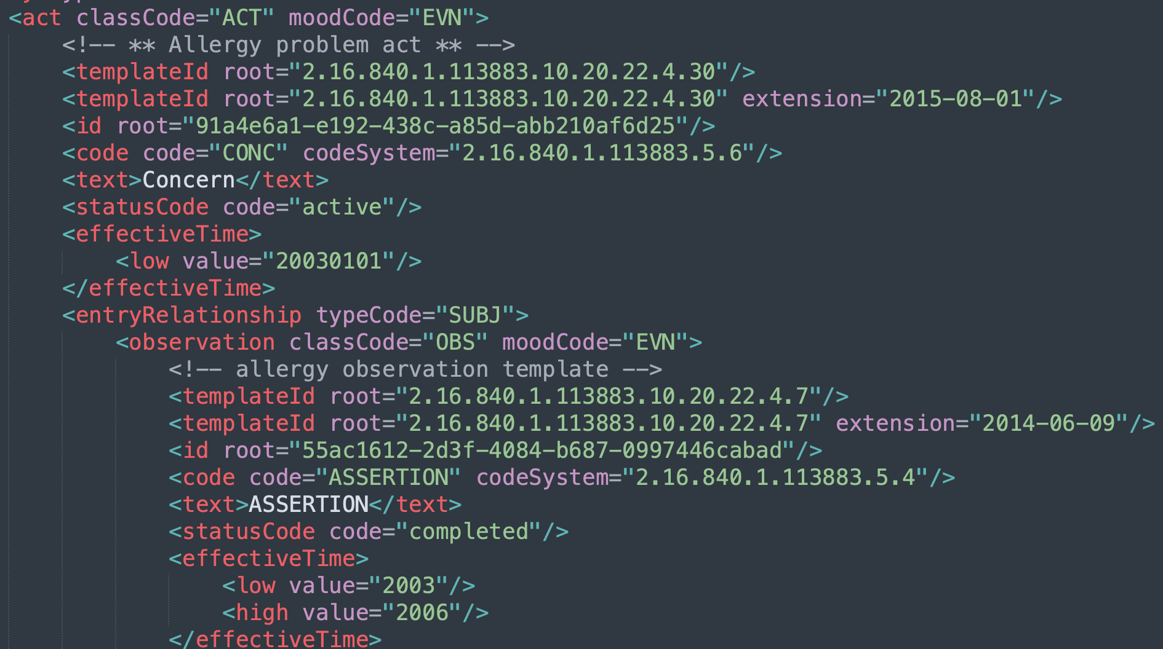

effectiveTime low and high
The 3rd entry has a low and high value of the observation of peanut
Availity
Google
MDIX & SMile
Oracle

Slide 14
PAMPI Gaps Filling - Immunizations

Slide 15



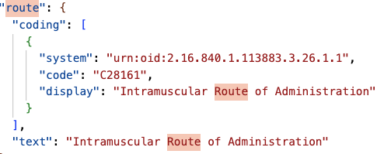
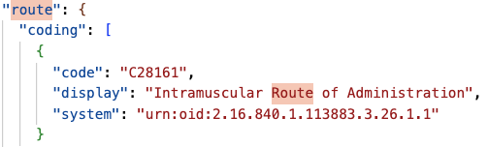
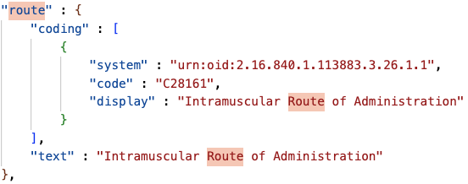
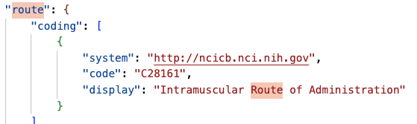
Repeat
G
M
O
S
Route
verify the URI before putting it to the rec ver

Slide 16
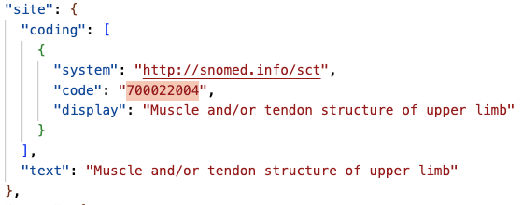
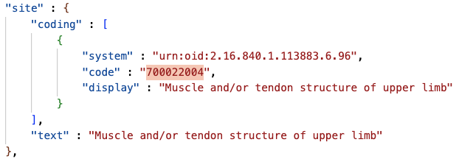
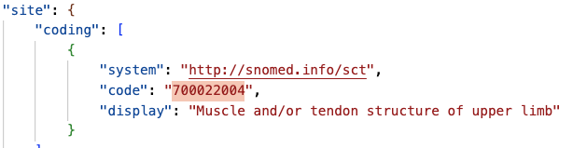
Site
M
O
S

Slide 17


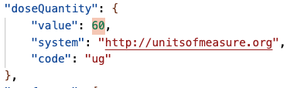
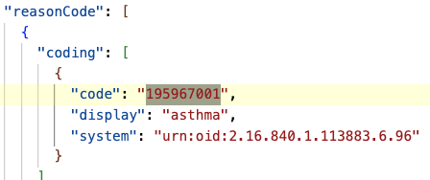
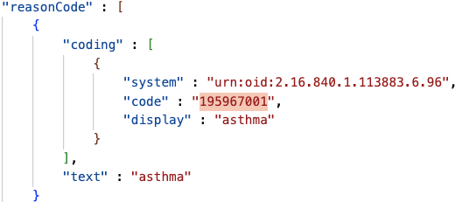
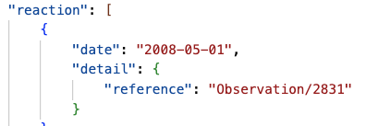
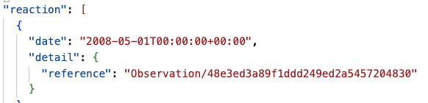

DoseQty
G
M
O
S
Indication
Reaction obs

Slide 18
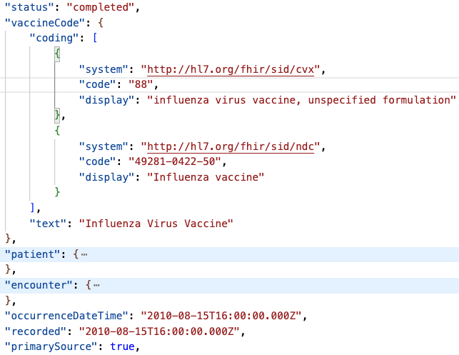
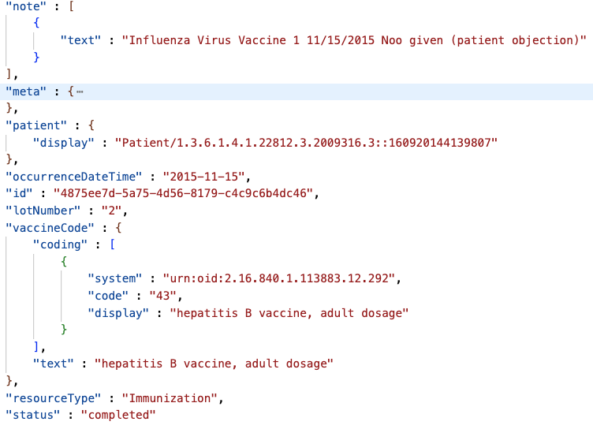
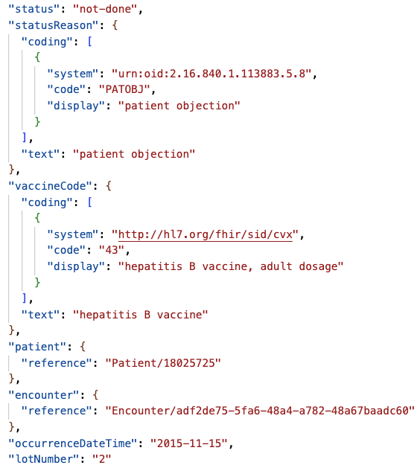
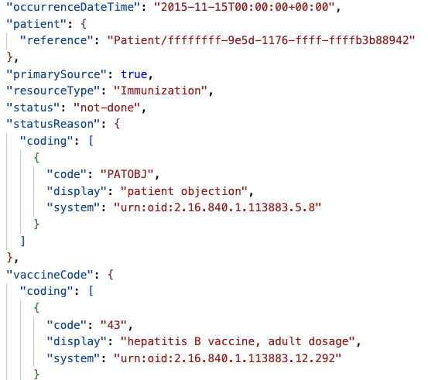
Negation and Refusal Reason
A
M
G
O
S: skipped the resource

Slide 19
Missed mapping attributes
No vendors mapped (source entry #1)
administrationUnitCode (in the not-easily-mappable, not-very-useful bucket),
manufacturedProduct id (not-easily-mappable, not-very-useful)
drug vehicle (not-easily-mappable, not-very-useful)
instruction (not-easily-mappable, not-very-useful)
No vendors mapped (source entry #2)
substance administration act (not-easily-mappable, not-very-useful)
precondition

